Slide 1


Why Chemistry Needs Python
Assistant Professor Dr. Dennis Svatunek
University of Malaya, 6th of November 2025

Slide 2


svatunek-lab.com
teaching.svatunek-lab.com
Research Talk: 11.11.2025 10 am

Slide 3
What is Computational Chemistry?
Computational chemistry is the science of simulating chemical systems on a computer.
It allows us to:
Model molecules and reactions instead of (or before) doing experiments
Simulate properties such as structure, energy, spectra, and reactivity
Explore mechanisms, reaction pathways, and material properties
Design new molecules, catalysts, and drugs using computation

Slide 4
What is Cheminformatics?
Cheminformatics combines chemistry, data science, and computer science to analyze, predict, and design chemical compounds using data.
It involves:
Representing molecules digitally (e.g., SMILES, fingerprints, graphs)
Searching and comparing chemical structures and properties
Predicting reactivity, toxicity, or activity using machine learning
Managing and visualizing large chemical datasets

Slide 5
Why Python in Chemistry?
Python is widely used across scientific disciplines for its clarity, flexibility, and large ecosystem of tools.
It allows chemists to:
Automate calculations, analyses, and simulations
Process and visualize chemical and experimental data
Connect quantum chemistry, molecular modeling, and AI tools
Build custom workflows for research and teaching

Slide 6
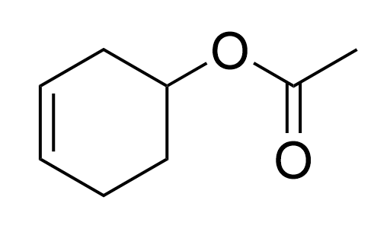
Digital Molecules
3-Cyclohexanyl acetate
O=C(OC1CC=CCC1)C
Simplified Molecular Input Line Entry System
SMILES

Slide 7
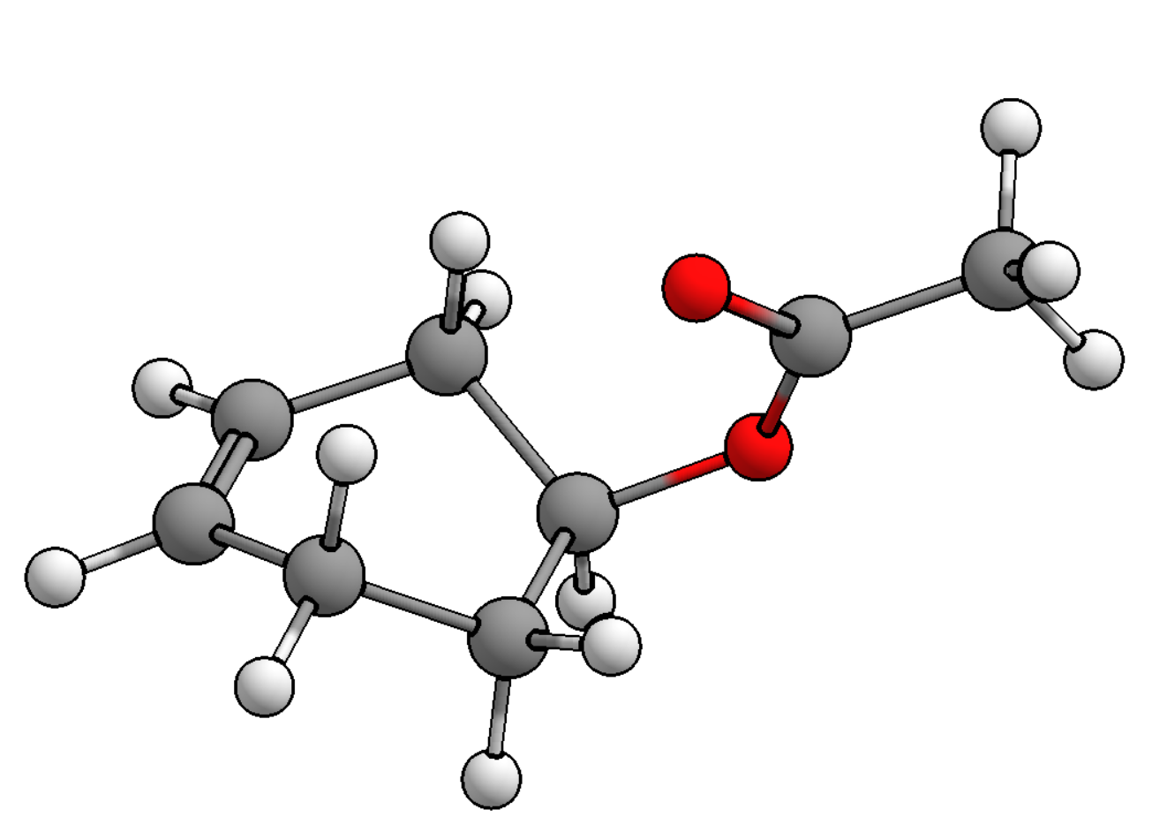
Digital Molecules in 3D
XYZ format
22
Comment line. Can be blank
O -1.446210000 1.270070000 0.747456000
C -0.486601000 1.223970000 1.563790000
O 0.625008000 0.401471000 1.330890000
C 0.808628000 -0.429382000 0.178474000
C 1.005920000 0.426254000 -1.096010000
C 0.928128000 -0.439367000 -2.323250000
C -0.050380100 -1.347130000 -2.424190000
C -1.040170000 -1.492780000 -1.300800000
C -0.314302000 -1.508160000 0.057636300
C -0.516296000 2.085090000 2.780130000
H 1.764670000 -0.977125000 0.333702000
H 1.989370000 0.942079000 -1.060740000
H 0.216833000 1.202730000 -1.170510000
H 1.683420000 -0.360387000 -3.099050000
H -0.093452100 -2.011200000 -3.281920000
H -1.746640000 -0.635417000 -1.331250000
H -1.625050000 -2.428280000 -1.430830000
H 0.140877000 -2.514170000 0.194326000
H -1.064870000 -1.395000000 0.868704000
H -0.203855000 3.115450000 2.511290000
H -1.542680000 2.110940000 3.203100000
H 0.177496000 1.682650000 3.547680000

Slide 8
RDKit
RDKit is an open-source cheminformatics toolkit for working with chemical structures in Python. It provides the core functionality needed to represent, analyze, and visualize molecules.
It allows us to:
Read and write molecules
Compute properties and molecular descriptors
Generate 2D depictions and 3D conformers
Search and compare structures (substructure, similarity)
Prepare data for machine learning and modeling

Slide 9

Practical Section 1
teaching.svatunek-lab.com/malaya1
In this section, we explore how chemistry can be represented and analyzed directly in Python using RDKit.

Slide 10
Machine Learning
Machine learning connects data with chemical properties and behavior.By training models on known data, we can predict properties of new molecules.
It allows us to:
Correlate molecular structure or descriptors with properties
Predict activity or stability of new compounds before synthesis
Classify molecules into functional or activity groups
Accelerate discovery by learning from experimental or computed datasets

Slide 11
Decision Tree
A decision tree predicts an outcome by repeatedly splitting data based on feature thresholds, creating a series of if–then rules that lead to a final prediction at each leaf.
Hungry?
yes
no
Vegetarian?
Get a drink!
yes
no
Get a salad!
Get chicken rice!

Slide 12
Decision Tree
A decision tree predicts an outcome by repeatedly splitting data based on feature thresholds, creating a series of if–then rules that lead to a final prediction at each leaf.
In regression it predicts the average value of samples in a leaf, while in classification it predicts the most common class.

Slide 13
Random Forest
A random forest combines the predictions of many individual decision trees, each trained on different subsets of data, to produce a more accurate and stable overall result.

Slide 14

Practical Section 2
teaching.svatunek-lab.com/malaya2
In this section, we learn how to make predictions from chemical data with basic machine learning tools.

Slide 15
Bonus: Quantum Chemistry in Python
PySCF brings quantum mechanics into Python, allowing us to compute chemical properties directly from first principles.
With only a few lines of code, we can run quantum-mechanical calculations, and analyze results.
It allows us to:
Compute molecular energies, orbitals, and electron densities
Optimize structures or scan reaction coordinates
Visualize orbitals and charge distributions interactively

Slide 16

Bonus: Practical Section 3
teaching.svatunek-lab.com/malaya3
In this section, we explore how quantum mechanics can be used to calculate molecular structures, energies, and properties from first principles.

Slide 17

svatunek-lab.com
teaching.svatunek-lab.com
dennis.svatunek@tuwien.ac.at

